Slide 1
Wavelength Calibration
Using the File mode in ISIS with a list of Ne/Ar lines
Woody Sims March 17, 2019

Slide 2
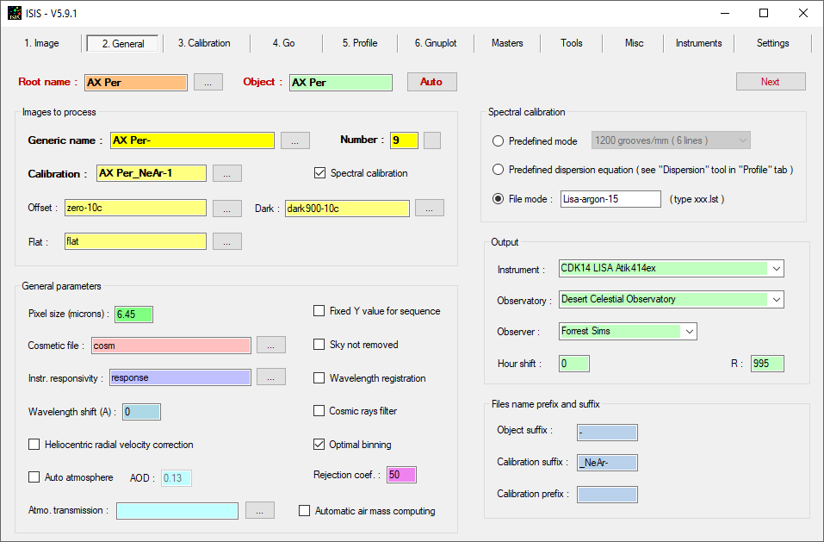
ISIS General tab – File mode

Slide 3
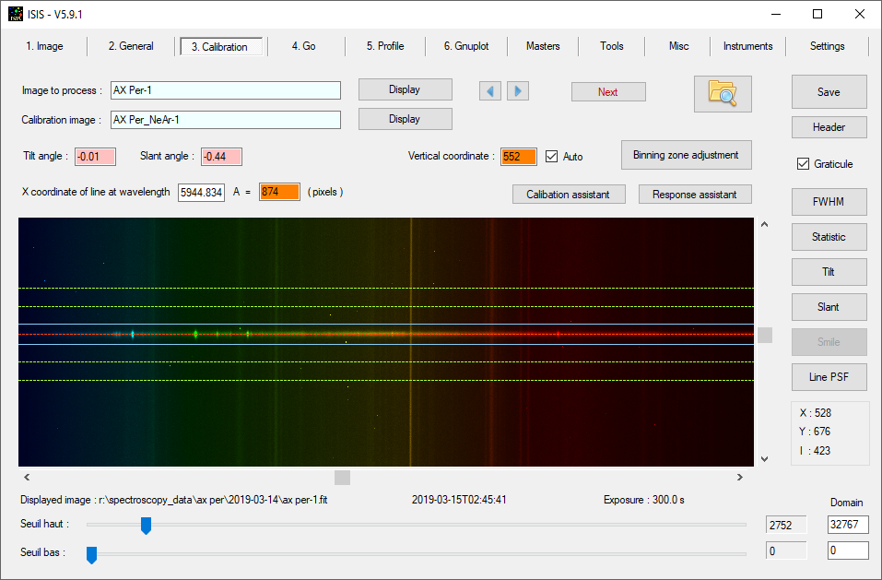
ISIS AX Per Raw Spectra

Slide 4
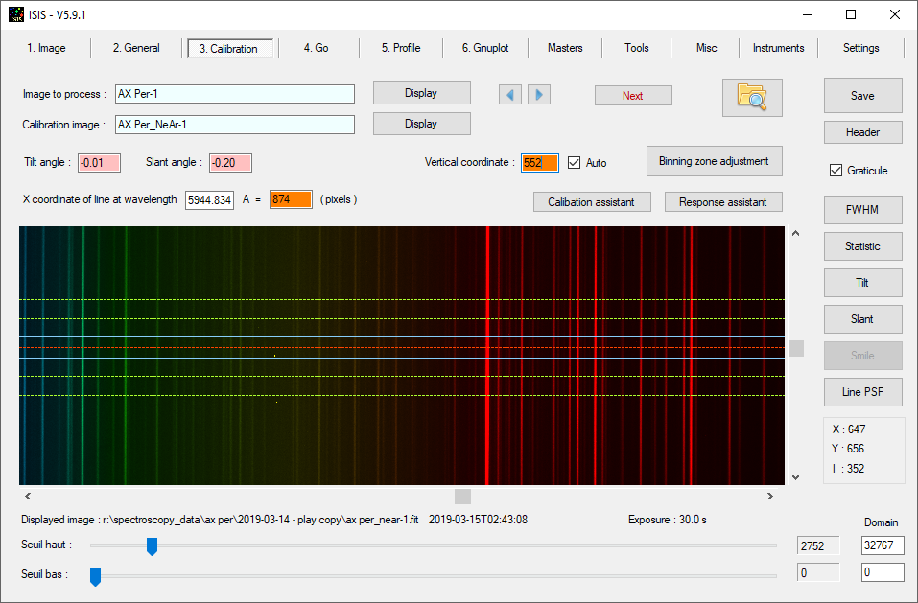
ISIS Ne/Ar lines from LISA Cal Lamp

Slide 5
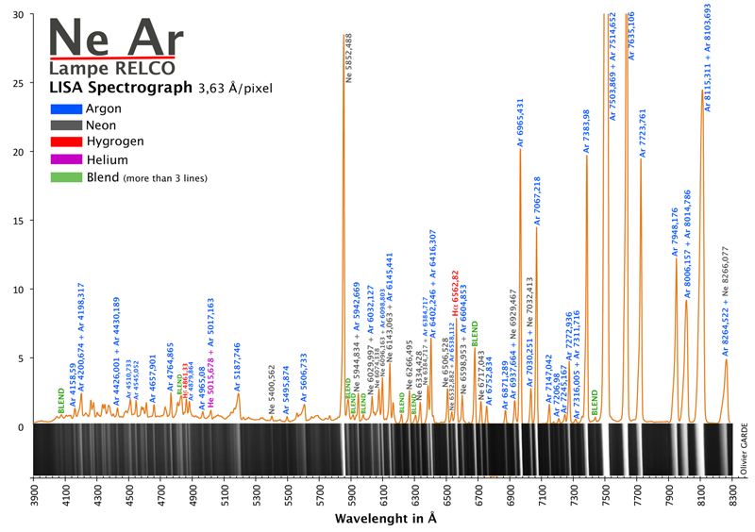
LISA Relco Ne Ar lamp lines annotated

Slide 6
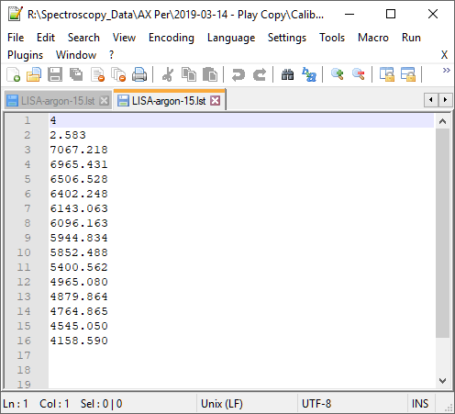
My Ne Ar line list used with ISIS File mode

Slide 7
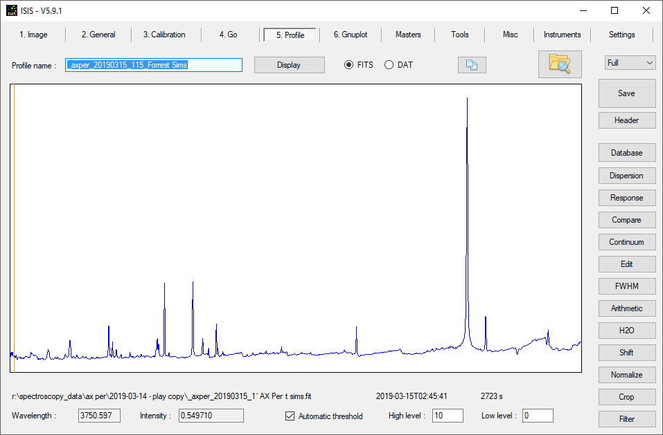
ISIS AX Per wavelength calibrated 1D spectrum

Slide 8
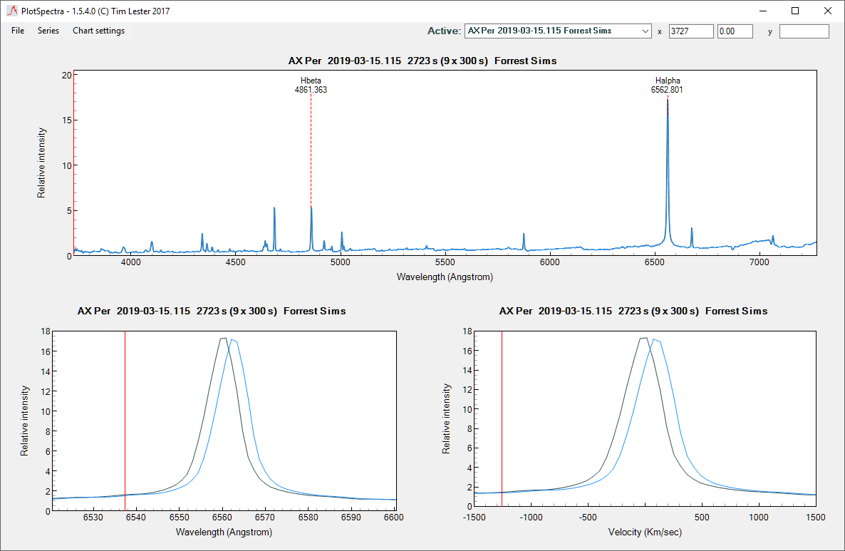
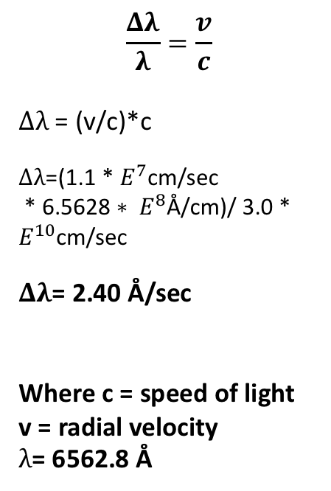
PlotSpectra AX Per wavelength shift
$$\frac{Δλ}{λ}=\frac{v}{c}$$
$Δλ$ = (v/c)*c
$Δλ$=(1.1 * $E^{7}$cm/sec
* 6.5628 ${∗ E}^{8}$Å/cm)/ 3.0 * $E^{10}$cm/sec
$Δλ$= 2.40 Å/sec
Where c = speed of light
v = radial velocity
$λ$= 6562.8 Å

Slide 9
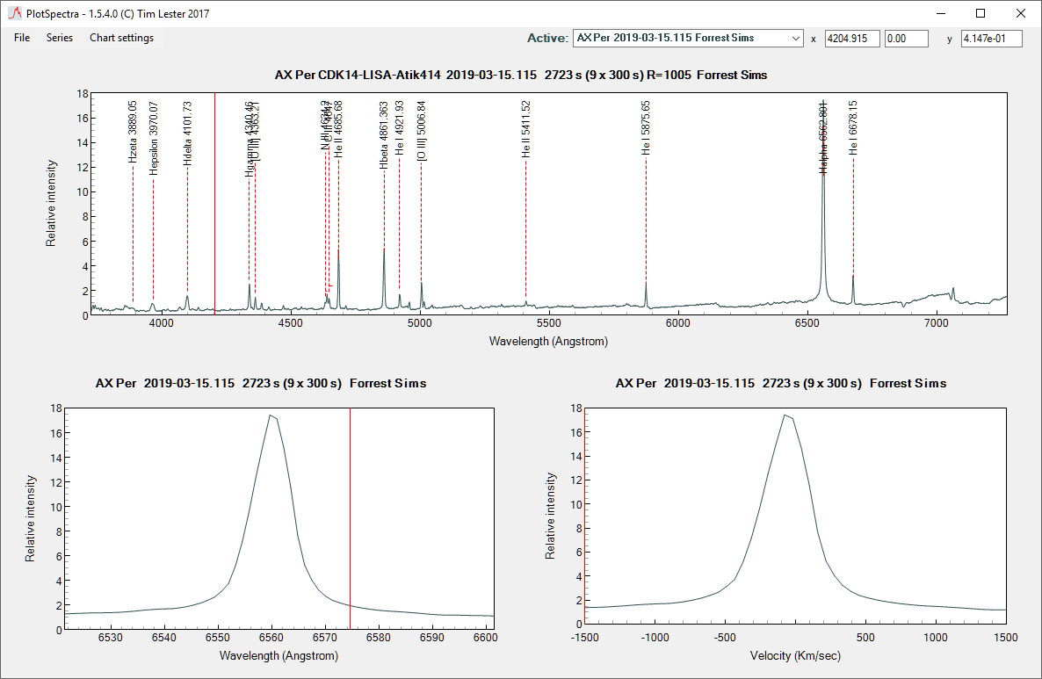
PlotSpectra AX Per Annotated spectrum

